Slide 1
CRIB Anapaw Inductory Manual
Yuji Sakaguchi March, 2016

Slide 2
Introduction
I assume that you have no experience or knowledge of ANAPAW.
This manual explains about the ways of conducting ANAPAW in CLI, defining histograms and how to look up valuables in order to calculate in the environment of CRIB.
Pictures in this manual were took in the environment of my PC, but the environment was not so different from the PC of CRIB. Then ANAPAW in PC of CRIB can be conducted with the procedures explained in this manual.
I assume that the structure of directories, the names of files and source codes for this manual were the PC in CRIB in 2015.

Slide 3
Contents
How to conduct in CLI to obtain histograms
analogin, anapaw, a/l, book, start, hst
reference to command
Defining histograms
Analyzer ID, Detector ID, Valuable ID
Structure of anafile
Definition of gate
How to define histograms
Valuables in source codes
How to look up valuables among source codes

Slide 4

How to conduct in CLI to obtain histograms
First of all, I explain how to enter the system of ANAPAW.
A part of my terminal
Input “analogin” from the terminal of analys2 (PC in CRIB).

Slide 5
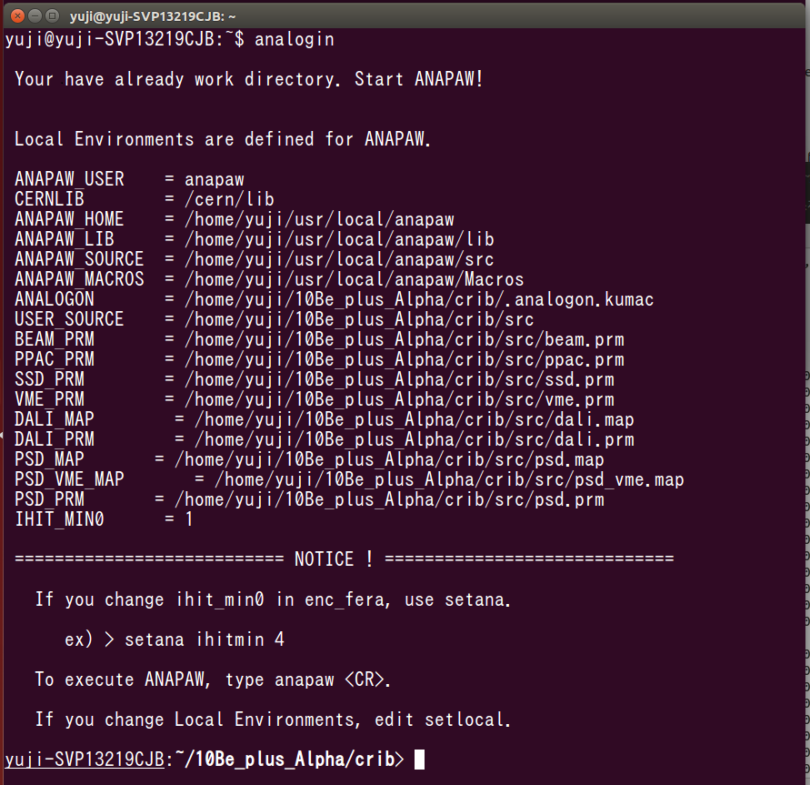
How to conduct in CLI to obtain histograms
You can enter into a directory which includes the system of ANAPAW.
A part of my terminal

Slide 6
Directories you should focus on
How to conduct in CLI to obtain histograms
Input “ls”. Then files and directories in ANAPAW show up.
Beginners should focus on the directories as bellow.
rdf…Raw data of an experiment are included.
ana…”anafile” is icluded. Definition of histograms is performed by anafile.
src…source codes are included. Calculation of physical quantities such as channel, energy and time is performed with the source code.

Slide 7
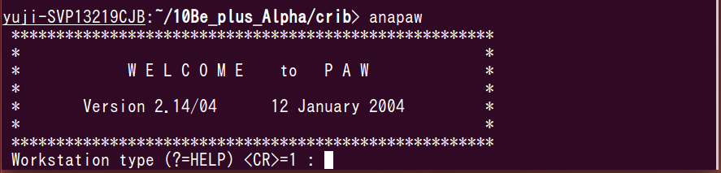
How to conduct in CLI to obtain histograms
After that, input “anapaw”. Your terminal becomes a state like the pictute bellow.
A part of my terminal
Push your enter key.

Slide 8
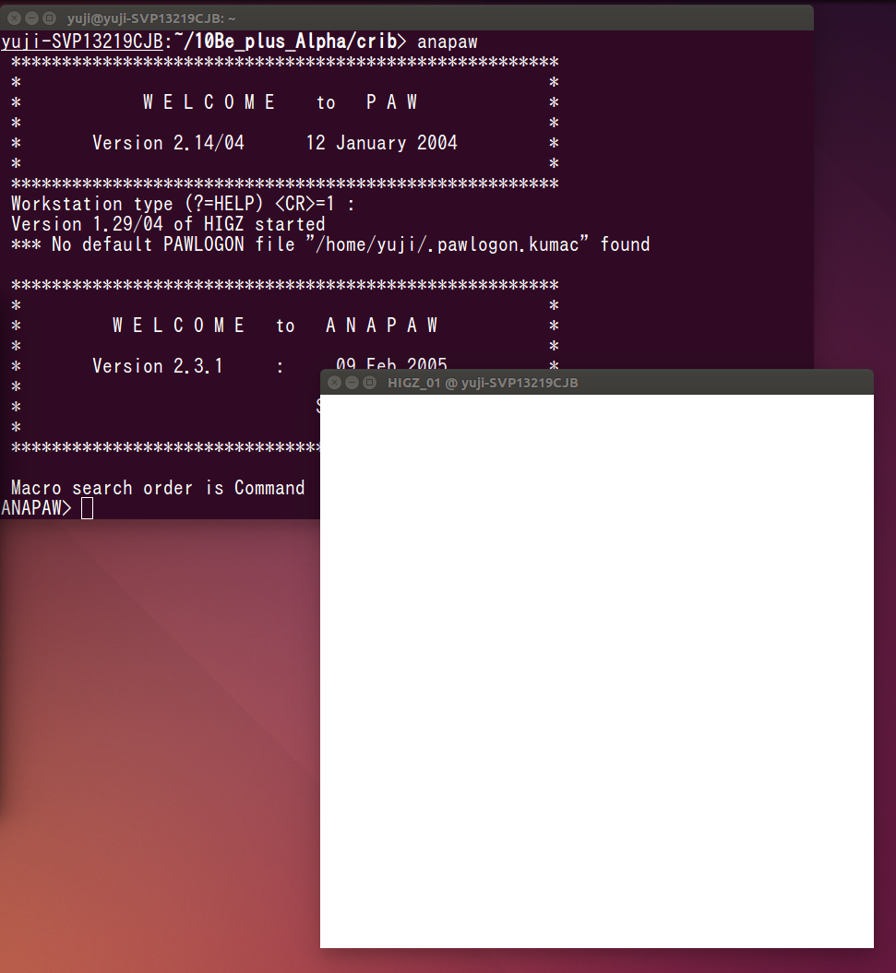
How to conduct in CLI to obtain histograms
Then a window shows up like this.
Histograms show up in this window if you perform commands in your terminal.
You finish entering the system of ANAPAW.
A part of my monitor of PC

Slide 9
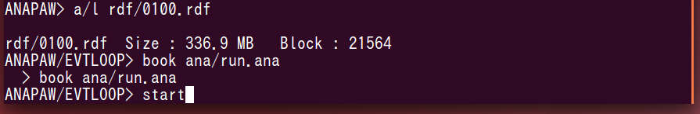
How to conduct in CLI to obtain histograms
From here I explain how to obtain histograms.
A part of my terminal
Select a file to Loop with “a/l (the name of a file to analyze)”
(If you analyze in online, you do not need the name of the file.）.
Select an anafile with “book (the name of an anafile)”.
Start Loop with “start”.
Loop…calculating valuables of physical quantity which correspond to detectors, and filling to create histograms

Slide 10
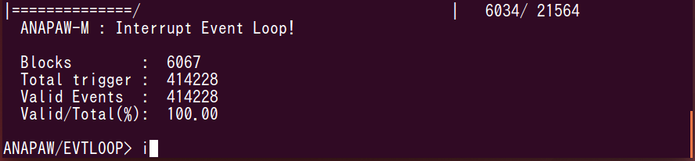
How to conduct in CLI to obtain histograms
As Loop is performed, this number is increased. Loop is automatically stopped if the calculation reaches the end. You can stop Loop with enter key though Loop is not finished.
A part of my terminal
Input “i”. Then ID of histograms (HID) show up.

Slide 11
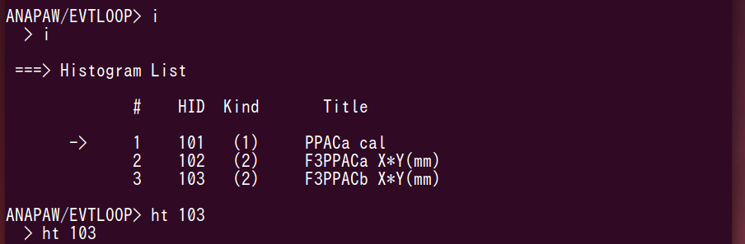
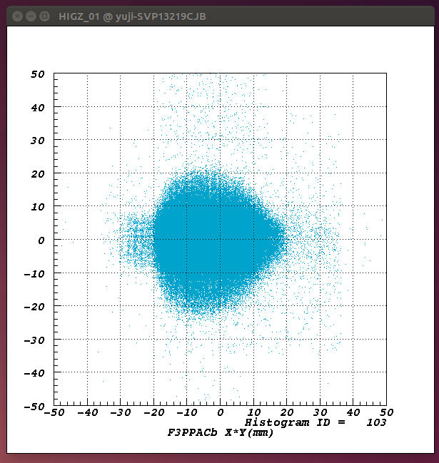
How to conduct in CLI to obtain histograms
Part of my terminal
Select a histogram you need.
Input “ht (HID)”.
Then the histogram show up in the window.

Slide 12
Reference to commands
How to conduct in CLI to obtain histograms
For the purpose of looking up commands of ANAPAW, a tutorial from Rilken RIBF is very helpful.
https://ribf.riken.jp/RIBFDAQ/index.php?plugin=attach&refer=Tools%2FAnalysis%2FANAPAW%2FTutorial&openfile=riken_guide.pdf
These commands as bellow are useful for you.
xf, opt logz, opt linz, xsta, hcut, prx…

Slide 13
Defining histograms
In order to define histograms, you need abilities as bellows.
・Understanding Analyzer ID, Detector ID and Valuable ID
・Understanding a structure of an anafile
・Understanding how to define a gate
・Understanding the way of defining histograms

Slide 14
Analyzer ID
Defining histograms
Physical quantities from measurements with detectors are treated as valuables in source code such as enc_psd.f and enc_ppac.f.
Each source code has Analyzer ID.
When you want to look up what Analyzer ID of a source code is in order to define histograms in an anafile, refer to usersrc.f in src.

Slide 15
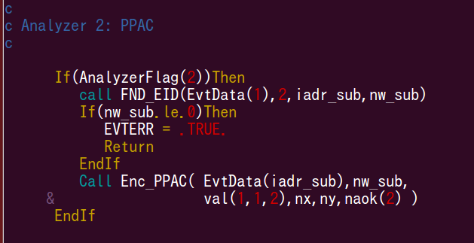
Analyzer ID and a source code
Defining histograms
View usersrc.f. There is a part like this picture.
Analyzer ID is 2.
Corresponding to
enc_ppac.f.
A part of usersrc.f

Slide 16
Detector ID and Valuable ID
Defining histograms
In source codes, correspondence between each detector and ID is written. Correspondence between each physical quantity from a detector and ID is also written.

Slide 17
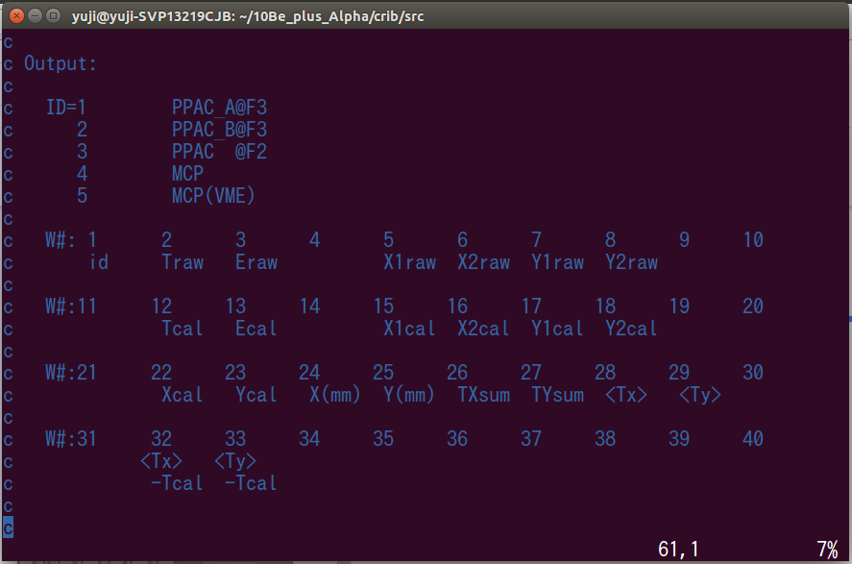
Defining histograms
Detector ID and Valuable ID in a source code
Detector ID and Valuable ID are written basically in the top part.
View enc_ppac.f. You should find a part like this picture.
Detector ID of PPACa in F3 chamber is 1.
Valuable ID of X (mm) is 24.
A part of enc_ppac.f

Slide 18
Structure of anafile
Defining histograms
anafile is composed of
.Analyzer ID area
.definition of xygate file area
.gate area
.definition of histograms area
・gate…selection effect of events
If you perform gates, only events which have valuables in a certain region are filled to histograms..
・xygate…two dimensional gate
Refer to “hcut”, a command for a two dimensional gate.
I explain a concrete structure and grammar of an anafile by using a certain anafile.

Slide 19
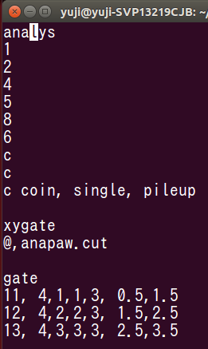
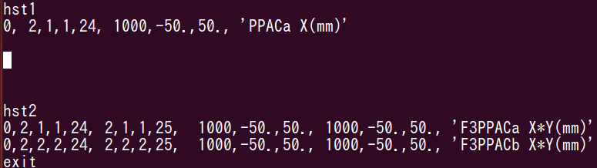
Structure of anafile
Defining histograms
①.Analyzer ID area
If you understand
③. gate area
④. definition of histograms area,
you do most of ANAPAW.
Then I explain those two.
②. definition of xygate file
area
③. gate area
④. definition of
histograms area
A part of a certain anafile

Slide 20
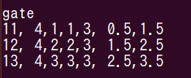
Defining histograms
Definition of gate
In ③. gate area, some numbers are arranged. Each number has meaning, and there is a rule of the order of the numbers.
I explain those by using this picture.
A part of an anafile
You define ID of a new gate here.
A region of the valuable as a gate.
Here the region of the gate is 1.5-2.5.
The order is
Analyzer ID, Detector ID, Detector ID, Valuable ID
a valuable which is used for a gate is designated.

Slide 21
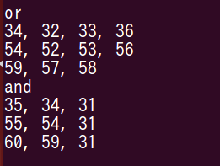
Defining histograms
Definition of gate
New gates can be made from the gates already made above with taking OR or AND.
ID of gates already made.
With taking OR,
new gate of 54 is made from 52, 53 and 56.
With taking OR, making new gates.
A part of an anafile
New gate ID
ID of gates already made.
With taking AND,
new gate of 55 is made
from 54 and 31.
With taking AND, making new gates.
New gate ID
gate ID is written in ④. definition of histograms, and it performs while Loop is processed.

Slide 22
Defining histograms
Definition of gate
Like this picture, ④. definition of histograms is composed of “hst1”, definition area for one dimensional histograms and “hst2”, definition area for two dimensional area.
A part of a certain anafile
You can define histograms by arranging meaningful numbers in a rule of the order.
I explain the meaning of numbers and the order.

Slide 23

Defining histograms
Definition of gate
One dimensional histogram
Definition of a shape of histograms
The order is
the number of bin, minimum value, maximum value
Name of a histogram
gate ID
You can designate which gate you use.
A part of a certain anafile
Designation of a valuable filled to a histogram.
The order is
Analyzer ID, Detector ID, Detector ID, Valuable ID

Slide 24

Defining histograms
Definition of gate
Two dimensional histogram
Definition for a horizontal axis.
The meaning and the order are same with those of one dimensional histograms.
Definition for a vertical axis.
The meaning and the order are same with those of one dimensional histograms.
A part of a certain anafile
“exit” means the end of an anafile. Sentences after “exit” are ignored. Therefore you can use “exit” in order to debag.
When you input “book” in your terminal, designate the anafile you rewite and Loop. Then you can obtain histograms you designed.

Slide 25
Valuables in source codes
You are required to calculate valuables derived from measured values such as energies and positions for your analysis.
For the calculation, you are required to understand how valuables are written in source codes.
I explain an introductory way of looking up valuables.

Slide 26

Valuables in source codes
valuables derived from measured values are treated as arrays which are named as “val1” or “val2”, and the arrays are shared among source codes.
View enc_recoil.f. There are sentences like this picture.
A part of enc_recoil.f
Valuables calculated in enc_psd.f are stored to arrays named as val1.
Valuables calculated in enc_psd_vme.f are stored to arrays named as val2.

Slide 27
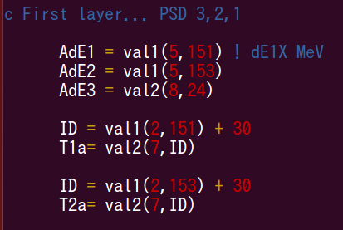
Valuables in source codes
val1 and val2 are arrays. Therefore you are required to understand correspondence between each element and each measured value. View enc_recoil.f.
A part of enc_recoil.f
Like this picture, there are sentences such as “val1(5,151)”.
I explain the way of looking up what physical quantity val1(5,151) means.

Slide 28
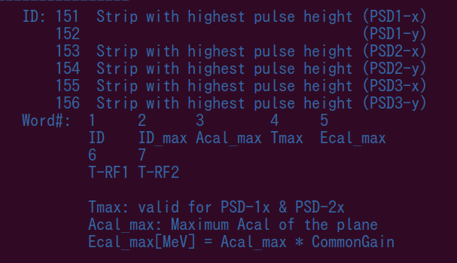
Valuables in source codes
I explained above that the pair “5,151” from the val1(5,151) corresponds to the valuable ID, and valuable IDs are written in the upper side of source codes. The val1 is an array coming from enc_recoil.f. View the upper side of enc_recoil.f.
A part of
enc_psd.f
The number “5” of the val1(5,151) corresponds to “Word#”, and “5” corresponds to “Ecal_max”.
The left number of the two numbers which point out one array corresponds to Word#.
“151” corresponds to the valuable ID of 151 which is linked to “Strip with highest pulse height (PSD1-x)”. We can guess that val1(5,151) is a valuable which is used for an calculation for the highest energy of the strips in PSD1-x.

Slide 29
Valuables in source codes
I explained how to look up the correspondence between valuables and physical quantities by using sentences written in the upper side of the source codes.
Some people change the sentences during experiments. Therefore the correspondence can be broken easily.
You should read source codes referring to the sentences, and confirm the correspondence.
If you change some sentences in the source codes, you need to complie in order to reflect the change.
“make” of Anapaw is “makeana”.

Slide 30
If you learn to calculate physical quantities with the source codes, define histograms with the anafiles and conduct Anapaw with CLI, you finish obtaining the skills to analyze with Anapaw.
You can get better at using Anapaw by analyzing actual data with considering by yourself, looking up ambiguous points and remembering those.

Slide 31
Reference for Anapaw installation
Daid Kahl, who belonged to CRIB group made a Web site for Anapaw installation.
http://www.cns.s.u-tokyo.ac.jp/~daid/physix/anapaw.html
I put an installation manual which was made by Dahee, who performed an experiment by CRIB in the directory including this manual.
I almost succeed in installing Anapaw in Dahee’s way, but there are still some bags in a font and hcut.
If you succeed in modyfing bags, please write the way in this manual.

